Slide 1
NCERT GEO: Class 6

Slide 2
Chapter 1: Earth and Solar system
Ursa Major constellation (Big bear): Saptha Rishis (Seven Sages also part of this).
Pole Star/ North Star remains in constant position: Spotted by the pointer star of the Seven sages.
Sun to Earth distance: 150 million Kms or 1 Astronomical unit.
Shortest revolution time: Mercury (88 days).
Pluto + 2003UB313 + Ceres : Dwarf plates of the solar system. Pluto ousted in August 2006.

Slide 3
Earth Facts
Third in solar system.
5th in size.
Diameter: 12,742 km.
Geoid in shape.
Lies in Goldilocks zone to sustain life.
Rotation time 23.96 hours.
Revolution time 365.26 days. (6 hours ignored every year forms a leap year)

Slide 4
Moon Facts
Diameter 1/4th that of earth.
Distance 3,84,400 km from earth.
Revolution time of Moon = Rotation time, hence we can only see on side of the moon.
Meteoroids: Pieces of rocks floating in space.
Asteroids: orbit around the sun in-between Jupiter and Mars.

Slide 5
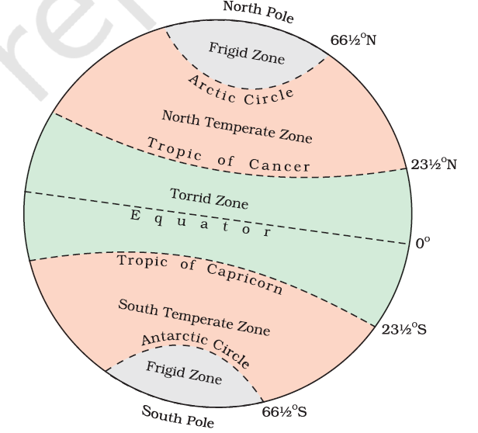
Chapter 2: Latitude and Longitude

Slide 6
Zones
Torrid Zones: Maximum light and heat – Mid day sun overhead – between Tropics of Cancer and Capricorn.
Temperate Zones: Sun rays slanting, lesser temp and light – Mid day sun never overhead – between the Tropics of Cancer/Capricorn and Artic zones.
Artic Zones / Frigid Zones: Sun never rises above the horizon – less light and heat – between the poles and Artic/Antarctic circles.

Slide 7
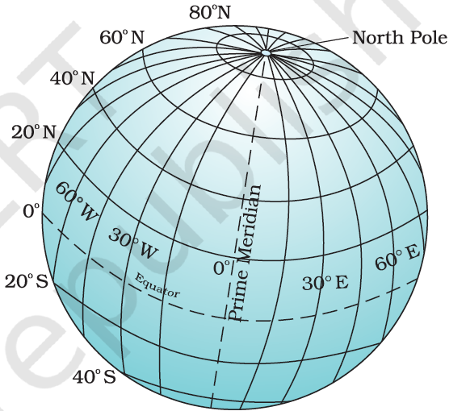
Longitudes
Called Meridians of Longitude.
Divided into Degrees, Minutes and Seconds.
Prime Meridian is 0 degree.
Passes through the British Royal Observatory in Greenwich.
Counting from 0 degree to 180 degree East/West.

Slide 8
Time Calculation
When sun is at the highest point in a meridian, all places in that meridian will have noon.
360 degrees rotation in 24 hours => 15 degree in 1 hour => 1 degree in 4 minutes.
East will be ahead of GMT, West will be behind GMT.
Every degree will have a 4 minute difference from GMT.

Slide 9
Indian Standard Time
India’s Longitudes: 68 degree East (East India) and 97 degree East (West India).
Common adopted time is of 82.5 degree East.
This is the Indian Standard Time Zone.
Multiple Time Zones: larger countries will have many Time Zones (Russia has 11).
Earth as 24 time zones of 1 hour each. Each Zone => 15 degree longitude.

Slide 10
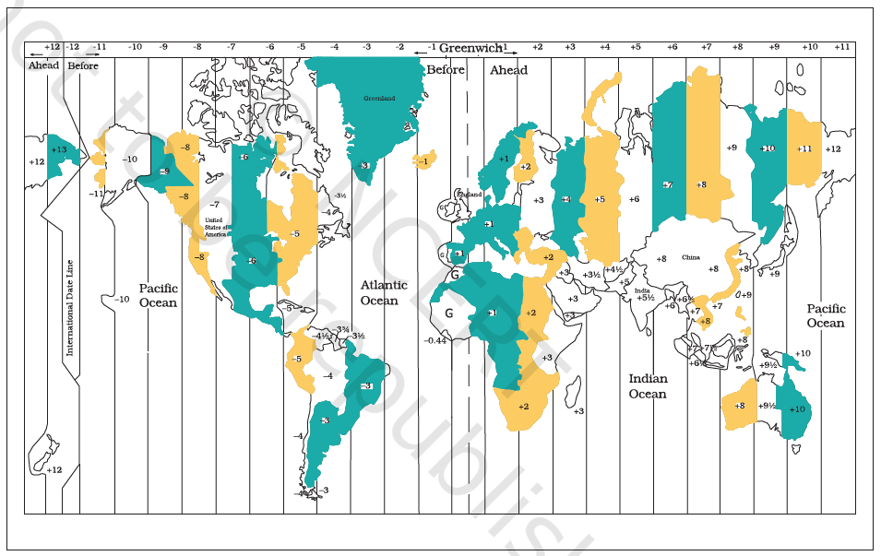

Slide 11
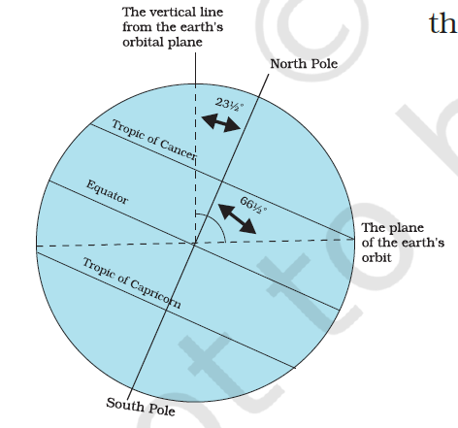
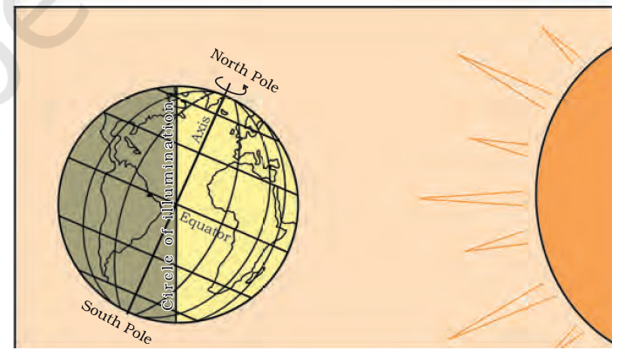
Chapter 3: Motions of the Earth

Slide 12
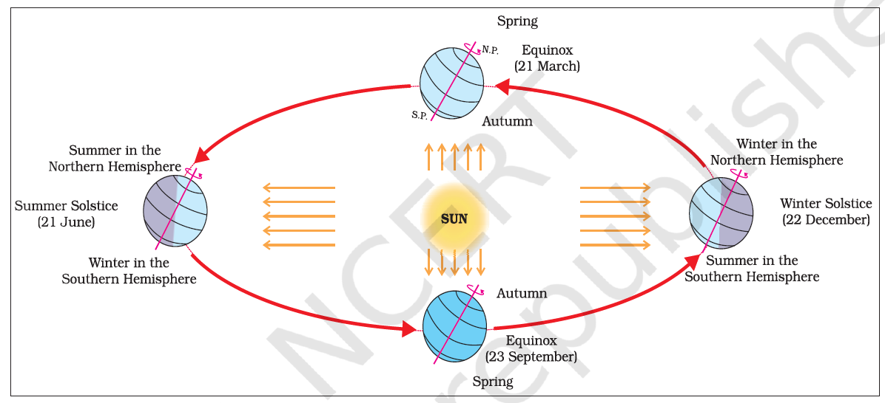
Seasons

Slide 13
Equinox and Solstice table
Season | Date
Summer(North) Solstice | 21st June
Spring(North) Equinox | 21st March
Winter(North) Solstice | 22nd December
Autumn(North) Equinox | 23 September

Slide 14
Chapter 5: Domains of Earth
Lithosphere: Solid portion. Consists of Continents and Ocean Basins.
Atmosphere: Gas surrounding.
Hydrosphere: Water portion.
Biosphere: narrow zone of land, water and air supporting life.

Slide 15
Lithosphere Facts
Ocean level same everywhere. Land elevation measure from 0 i.e. Sea level.
Highest point: Mount Everest 8,848 m – Lowest point: Mariana trench 11,022 m.
Mount Everest: 1st Tenzing Norgay(Ind), Edmund Hillary(NZ), 1953 – First woman: Junko Tabei (Japan, 1975) – First Indian woman: Bachendri Pal (1984).
Asia separated from Europe via the Ural Mountains. Combined with Europe: Eurasia.
Africa is the only continent which has Topics of Cancer/Capricorn and Equator passing. Longest river, Nile flows through Africa.
Andes is the world’s longest mountain range runs from North to South of South American continent. Largest river, Amazon flows here.
Indian missions in Antarctica: Maitri and Dakshin Gangothri.

Slide 16
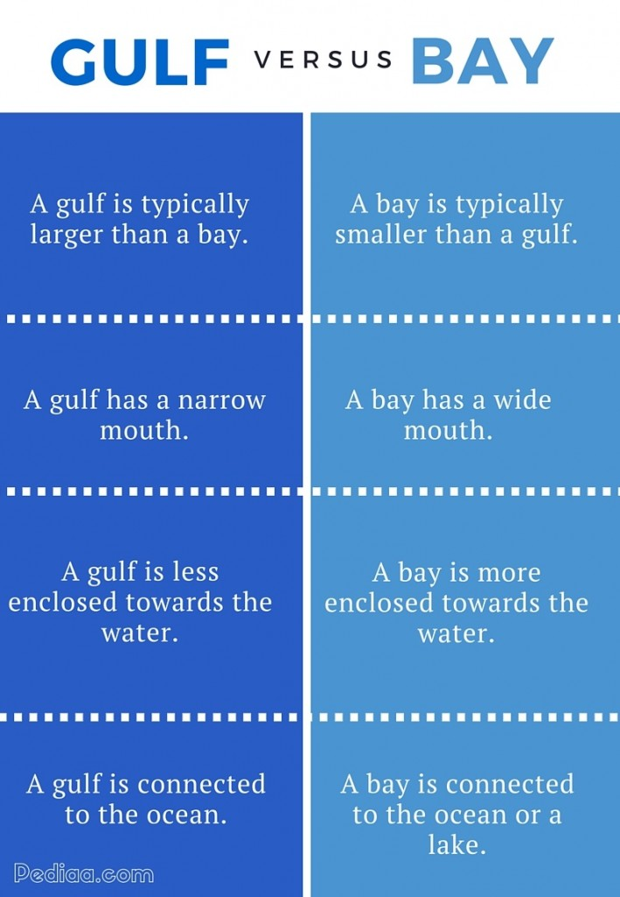
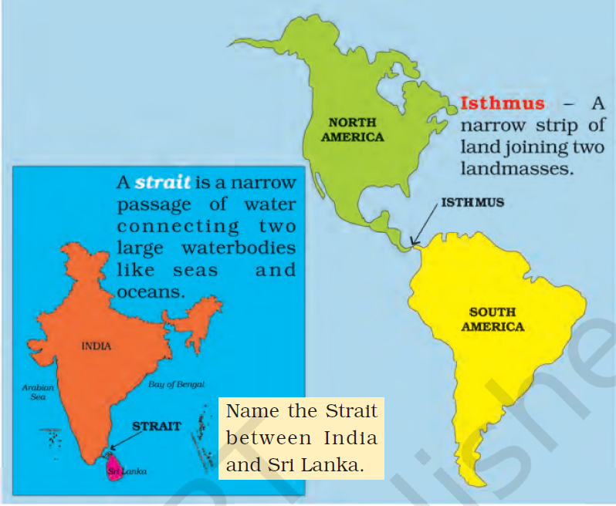

Slide 17
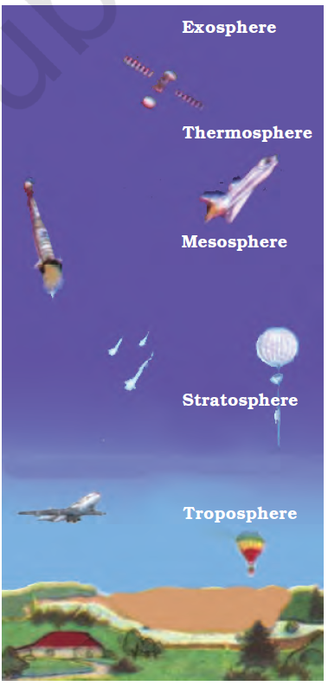
Atmosphere
Extends from ground level to 1600 kms.
Divided into 5 layers: Troposphere, Stratosphere, Mesosphere, Thermosphere and Exosphere.
Density and Temperature decreases with increase in height.
Air consists of 78% Nitrogen, 21 Oxygen, rest other gases including Carbon dioxide, Argon etc

Slide 18
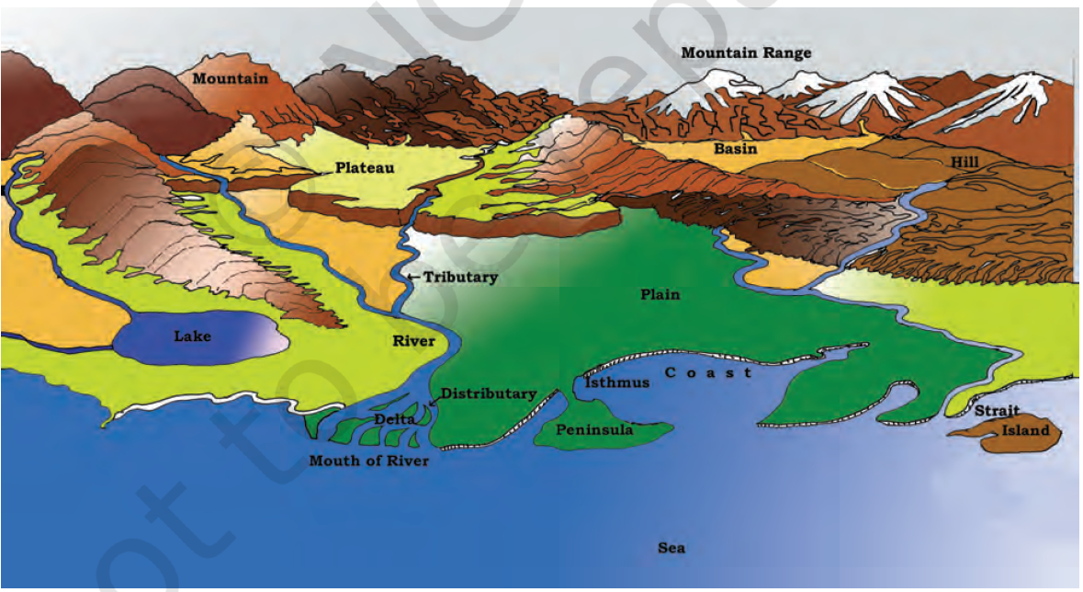

Slide 19
Chapter 6: Major Landforms on Earth
Land formation are created by: Internal (Upliftment and sinking) and External (Wearing down and rebuilding – Erosion and Deposition) processes.
Landforms: Mountains, Plateaus and Plains. NB: Any Hill above 600m is a mountain.
Mountains: Small summit, broad base, natural elevation – Frozen rivers (Glaciers)
Types of mountains: Fold, Block and Volcanic.

Slide 20
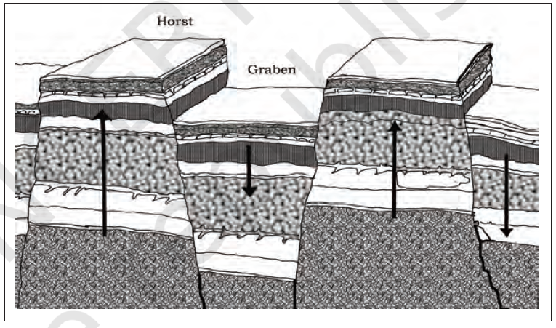
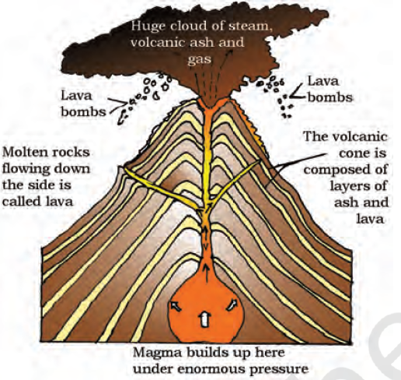
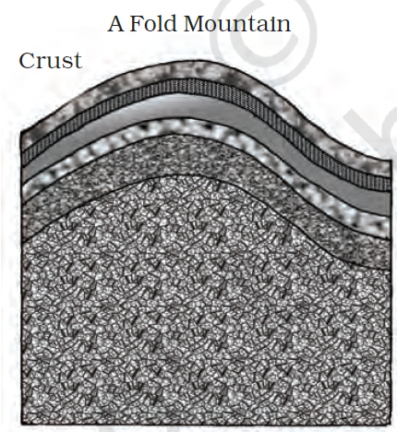

Slide 21
Fold Mountains
Aravali range one of the oldest fold ranges, worn due to erosion.
Himalayan and Alps are young mountain ranges – Rugged relief and high conical peaks.
Urals (Russia) and Appalachians (US): rounded peaks and low elevation – old fold mountains.

Slide 22
Block Mountains
Large areas broken and displaced horizontally.
Uplifted areas: Horsts.
Lowered blocks: Graben.
Eg: Rhine Valley, Vosges in Europe.

Slide 23
Volcanic Mountains
Formed due to Volcanic activity.
Eg: Mt Kilimanjaro in Africa and Mt Fujiyama in Japan.
Mauna Kea in Pacific ocean is underwater – higher than Mount Everest – 10,205m.

Slide 24
Plateaus
Elevated table top lands, flat tops, steep slopes.
Old plateaus: Deccan, East African (Kenya-Tanzania-Uganda), Western Australian.
Highest plateau: Tibetan Plateau, 4000-6000m above sea level.
Importance: Rich in mineral deposits, rich in black soil, fertile.
African plateau: Gold, Diamond – Chottanagpur: Iron, Coal and Manganese.
Also has waterfalls: Jog Falls in Karnataka and Hundru falls in Subernarekha river in Chottanagpur.

